Slide 1
Game Day Building
Post Tensioned Redesign
AE Senior Thesis Spring 2009
Matthew Haapala
BAE/MAE Structural Option
Faculty Consultant: Dr. Hanagan

Slide 2
Presentation Outline
Existing Conditions
Thesis Proposals and Goals
Gravity System Redesign
Lateral System Redesign
Foundation Optimization
Cost & Schedule Analysis
Lighting Redesign
Conclusions
Question and Answer

Slide 3
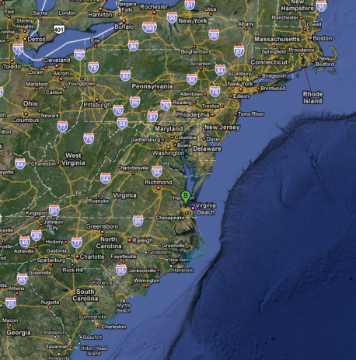
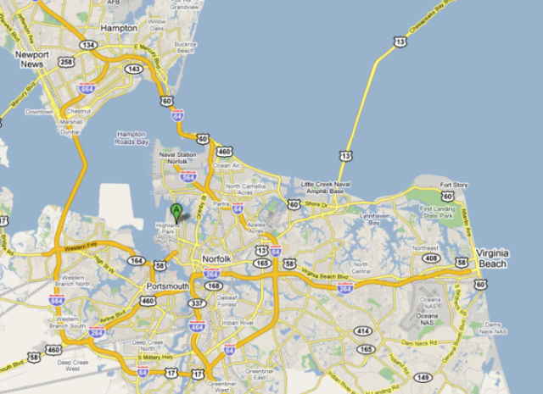
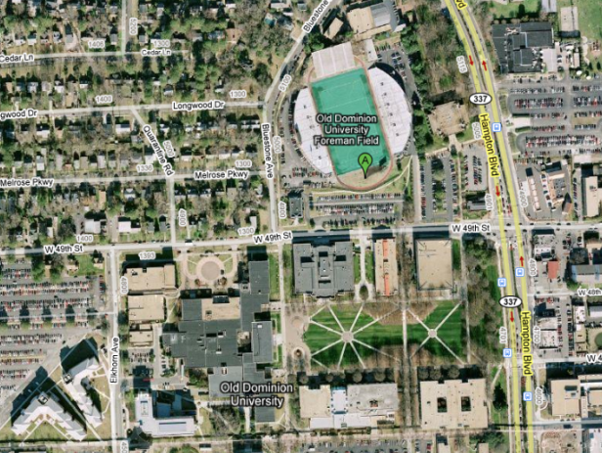
Game Day Building
Post Tensioned Redesign
Building Statistics
Building Statistics
Building Name: Foreman Field Game Day Building
Project Team:
  Owner - Old Dominion University
  General Contractor - S.B. Ballard Construction Company
  Architect - Ellerbe Becket
  Engineer - Clark Nexsen
Size : Gross Floor Area = 54,877 sq. ft. , Height = 47 ft.
  1st Floor = 16,500 sq. ft.
  2nd Floor = 16,100 sq. ft.
  3rd Floor = 11,500 sq. ft.
  4th Floor = 10,800 sq. ft.
Construction: Dates of February 22, 2008 thru July 22, 2009
Cost: $11.9 million
Project Delivery Method: Design-Building
Location: The Game Day building is currently under construction in the south end zone of Foreman Field on the campus of Old Dominion University in Norfolk Virginia.
By: Matthew Haapala
Existing Conditions
Thesis Proposal & Goals
Gravity System Redesign
Lateral System Redesign
Foundation Optimization
Cost & Schedule Analysis
Lighting Redesign
Conclusions

Slide 4
Game Day Building
Post Tensioned Redesign
Existing Gravity System
3rd Floor Structural Plan
Cast in Place Reinforced Concrete Flat Plate
Typical bay size 31’-6” x 17’-0”
Typical slab depth 12”
No shear caps or drop panels
Shear stud rails used to resist punching shear
Cast in Place Reinforced Concrete Beams
Located around openings and seating
Cast in Place Concrete Columns
18” x 18” typical
By: Matthew Haapala
Blue: Beam Location
Red: Column or Load Bearing Wall Location
Existing Conditions
Thesis Proposal & Goals
Gravity System Redesign
Lateral System Redesign
Foundation Optimization
Cost & Schedule Analysis
Lighting Redesign
Conclusions
Notes:
Gravity System:
Typical Slab depth on all three elevated floors & roof
Uniform Slab Depth Required By Architect
Depth Controlled By Flexure and Deflection Control in long direction
Lateral System
Reference Shear Wall Plan
% Capacity Used

Slide 5
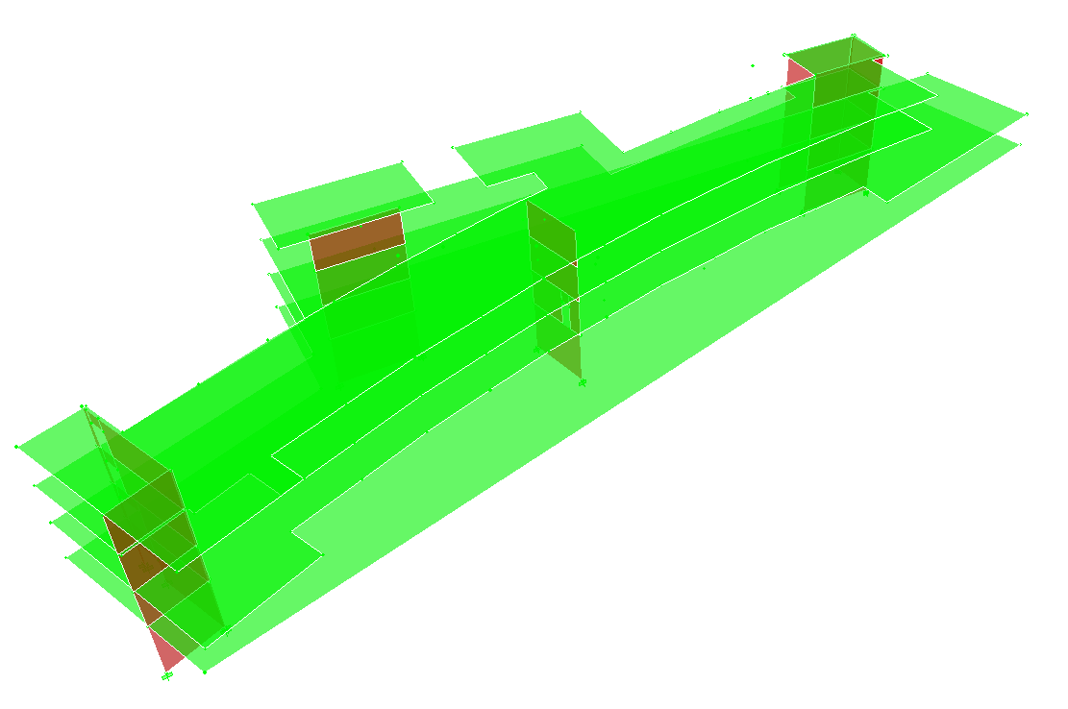
Game Day Building
Post Tensioned Redesign
Existing Lateral System
Existing Lateral System
Seven Cast in Place Reinforced Concrete Shear Walls
Located in Architecturally Convenient Locations
Capacity Significantly Exceeds Lateral Loading Demands
Column & Slab Moment Frames’ Stiffness not Considered
By: Matthew Haapala
Shear Wall Location Plan
ETABS Model of Existing Lateral System
Existing Conditions
Thesis Proposal & Goals
Gravity System Redesign
Lateral System Redesign
Foundation Optimization
Cost & Schedule Analysis
Lighting Redesign
Conclusions

Slide 6
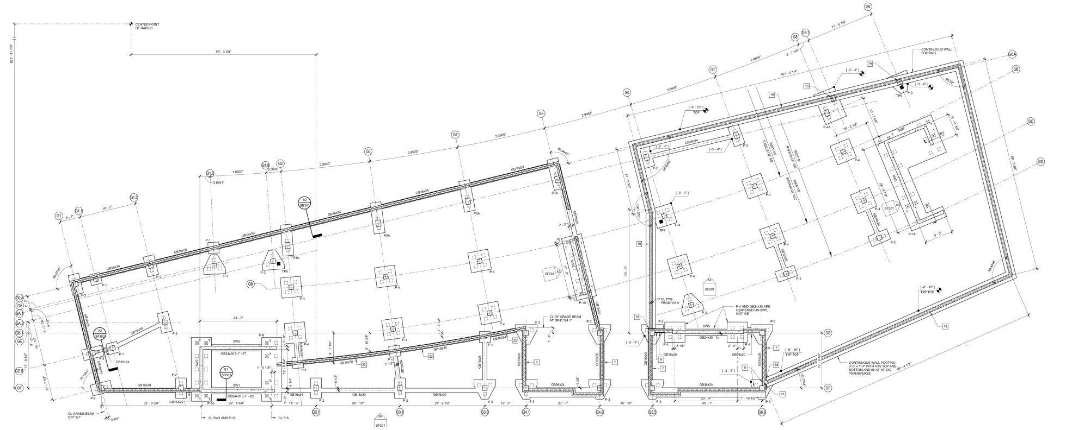
Game Day Building
Post Tensioned Redesign
Existing Foundations
Existing Foundations
Square Precast Prestressed Concrete (SPPC) Piles
100’ long from Tip to Cutoff
183 Piles Total
Typically Driven in Clusters of 4 Below Most Columns
Clusters of Up to 18 Below Shear Walls
Topped With 36” - 40” Deep Pile Caps
Grade Beams Below Exterior Walls & Between Pile Caps
By: Matthew Haapala
Foundation Plan
Existing Conditions
Thesis Proposal & Goals
Gravity System Redesign
Lateral System Redesign
Foundation Optimization
Cost & Schedule Analysis
Lighting Redesign
Conclusions
Notes:
Add existing Foundation Plan
100-110’ deep standard penetration test borings were conducted by G.E.T. Solutions, Inc

Slide 7
Game Day Building
Post Tensioned Redesign
Structural Depth Proposal
Structural Depth Proposal
Study 1 Gravity System Redesign
Problem: Two-way flat plate is structurally inefficient floor system
Solution: Replace with one-way slabs on post tensioned beams
Goals:
  Reduce slab depth
  Develop understanding of post tensioned concrete design
  Use post tensioning to minimize beam depth
  Reduce self weight of the structure
Study 2 Lateral System Redesign
Problem: Shear walls’ excess capacity suggests reduction possible
Solution: Consider Moment Frames in Lateral Design and Remove Existing Shear Walls Where Practical
Goals:
Utilize Post Tensioned Beams in Ordinary Concrete Moment Frames
Reduce The Number of Shear Walls
Study 3 Foundation Optimization
Problem: With poor soils extensive deep foundations required
Solution: Analyze foundation requirements of redesigned structure to determine possible foundation reductions
Goal: Reduce the number of piles
By: Matthew Haapala
Existing Conditions
Thesis Proposal & Goals
Gravity System Redesign
Lateral System Redesign
Foundation Optimization
Cost & Schedule Analysis
Lighting Redesign
Conclusions
Notes:
Architectural Requirement of Uniform Slab Depth
The Aspect Ratio of Most Bays are Between 2:1 and 4:1

Slide 8
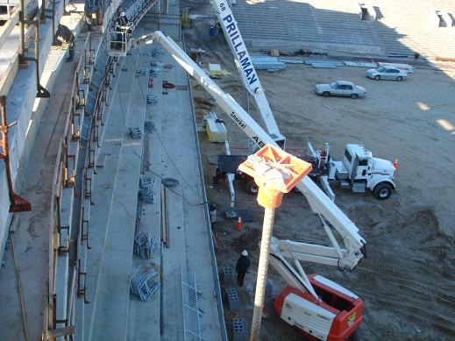
Game Day Building
Post Tensioned Redesign
C.M. Breadth Proposals
C.M. Breadth Proposals
Problem: Unknown cost, constructability, and construction schedule impacts of structural redesign
Solution: Conduct cost and schedule analyses comparing of the original and redesigned structure
Goals:
  Lower the price of the structure
  Develop a construction sequence that satisfies the unique demands of post tensioning
  Do not Increase the Overall Project Duration
By: Matthew Haapala
Existing Conditions
Thesis Proposal & Goals
Gravity System Redesign
Lateral System Redesign
Foundation Optimization
Cost & Schedule Analysis
Lighting Redesign
Conclusions
Notes:
Architectural Requirement of Uniform Slab Depth
The Aspect Ratio of Most Bays are Between 2:1 and 4:1

Slide 9
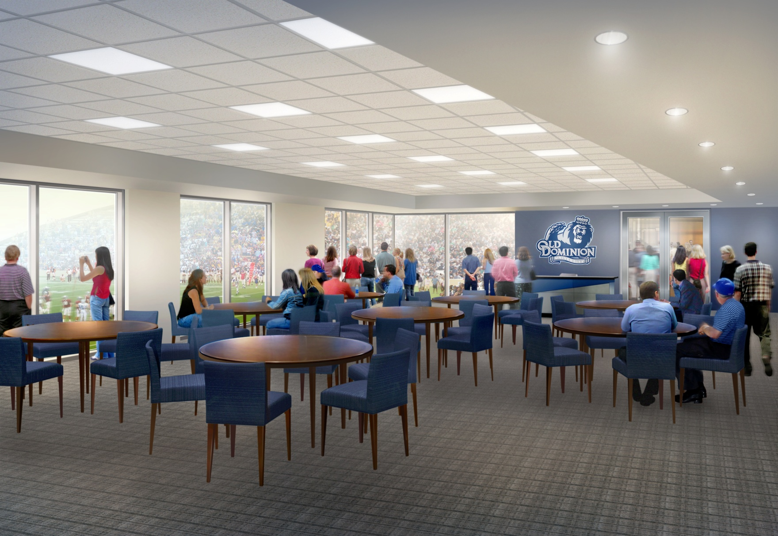
Game Day Building
Post Tensioned Redesign
Lighting Breadth Proposal
Lighting Breadth Proposal
Problem: Original lighting design predominantly inexpensive troffers and cans
Solution: Create an alternate lighting scheme for the scholarship lounge
Goals:
  Integrate the structural redesign into the redesigned lighting scheme
  Make the room seem more spacious have emphasizing the peripherals by having a high luminance on the Walls and Ceiling.
  Increase flexibility by specifying dimmable fixtures
  Satisfy ASHRE 90.1 and IESNA Lighting Handbook requirements
  Use attractive or concealed luminaries
By: Matthew Haapala
Existing Conditions
Thesis Proposal & Goals
Gravity System Redesign
Lateral System Redesign
Foundation Optimization
Cost & Schedule Analysis
Lighting Redesign
Conclusions
Notes:
Architectural Requirement of Uniform Slab Depth
The Aspect Ratio of Most Bays are Between 2:1 and 4:1

Slide 10
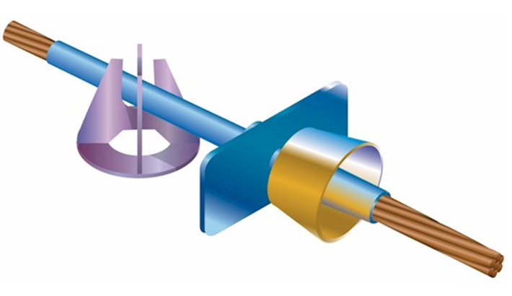
Game Day Building
Post Tensioned Redesign
Gravity System Redesign
By: Matthew Haapala
Existing Conditions
Thesis Proposal & Goals
Gravity System Redesign
Lateral System Redesign
Foundation Optimization
Cost & Schedule Analysis
Lighting Redesign
Conclusions
Notes:
270 ksi low relaxation unbounded monostrand tendons
Assumed lump sum 15ksi effective prestress losses
Results in effective prestress of 26.6 k/tendon
Light Weight Concrete not available in higher strength than 4000 psi

Slide 11
Game Day Building
Post Tensioned Redesign
Gravity Loading Assumptions
By: Matthew Haapala
Existing Conditions
Thesis Proposal & Goals
Gravity System Redesign
Lateral System Redesign
Foundation Optimization
Cost & Schedule Analysis
Lighting Redesign
Conclusions

Slide 12
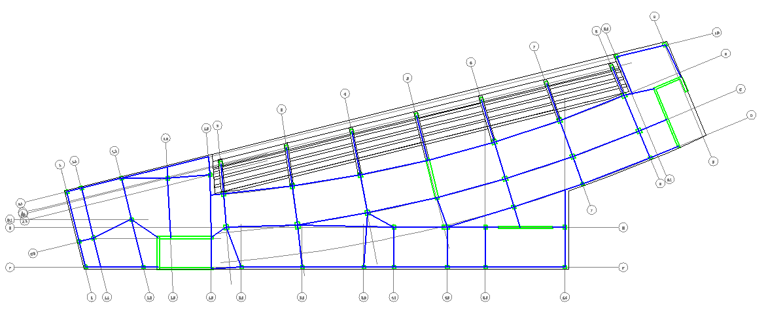
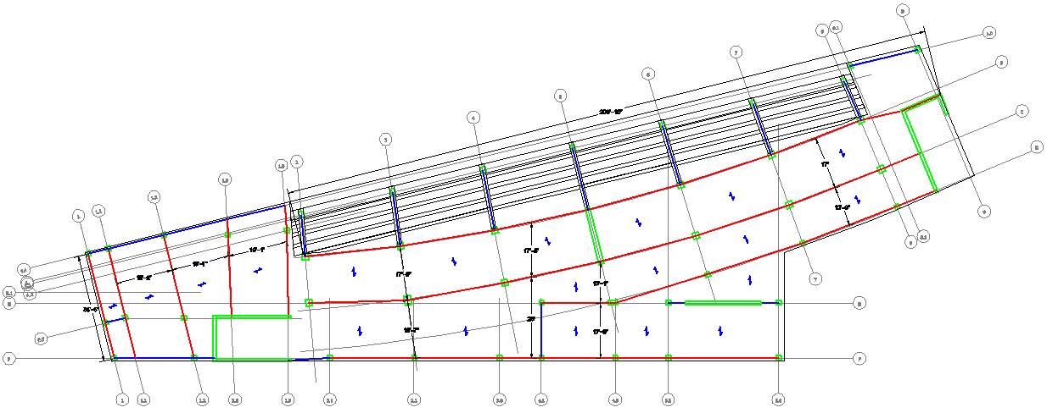
Game Day Building
Post Tensioned Redesign
Trial Layout Development
Trial Layout Development
By: Matthew Haapala
Existing Conditions
Thesis Proposal & Goals
Gravity System Redesign
Lateral System Redesign
Foundation Optimization
Cost & Schedule Analysis
Lighting Redesign
Conclusions

Slide 13
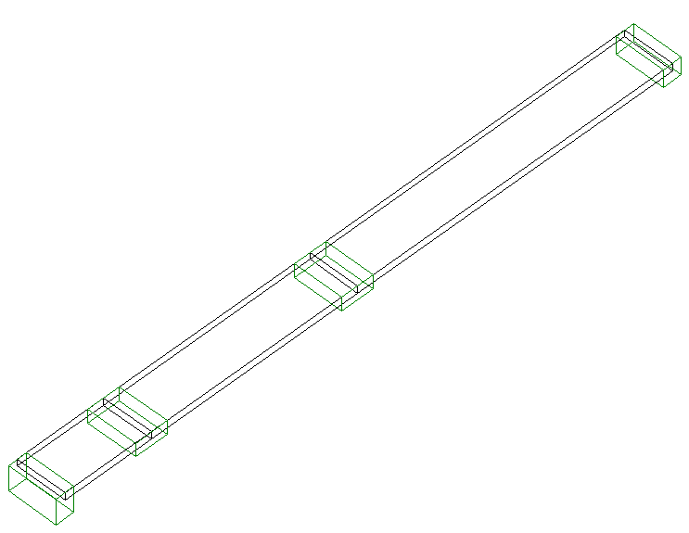
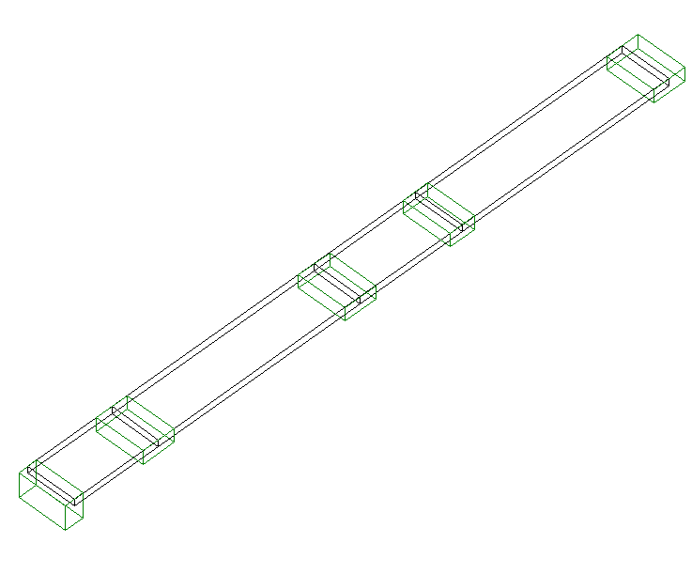
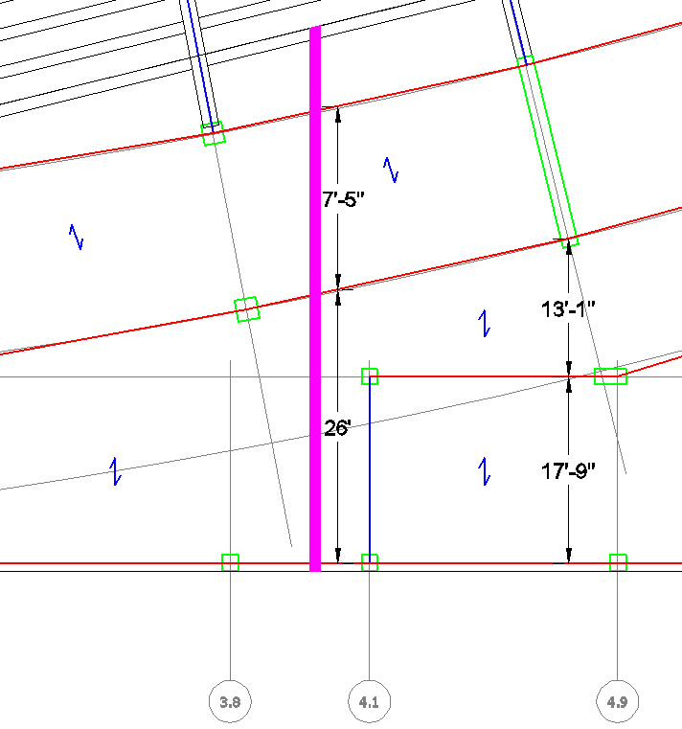
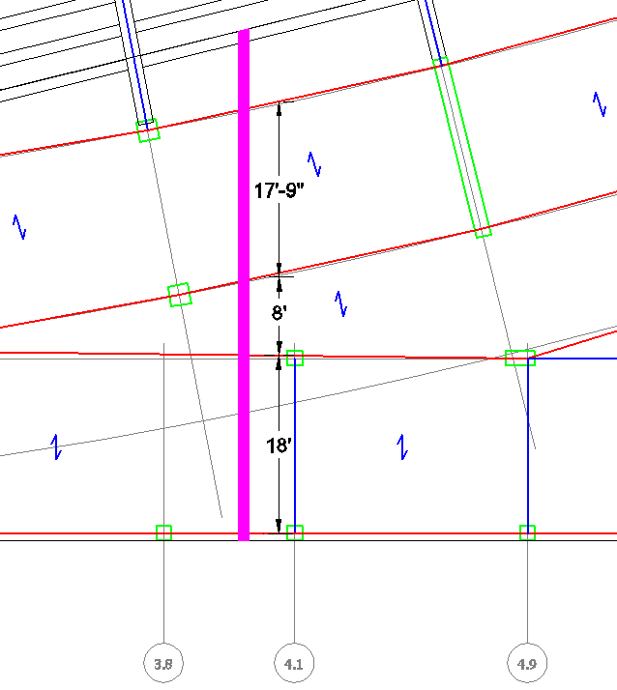
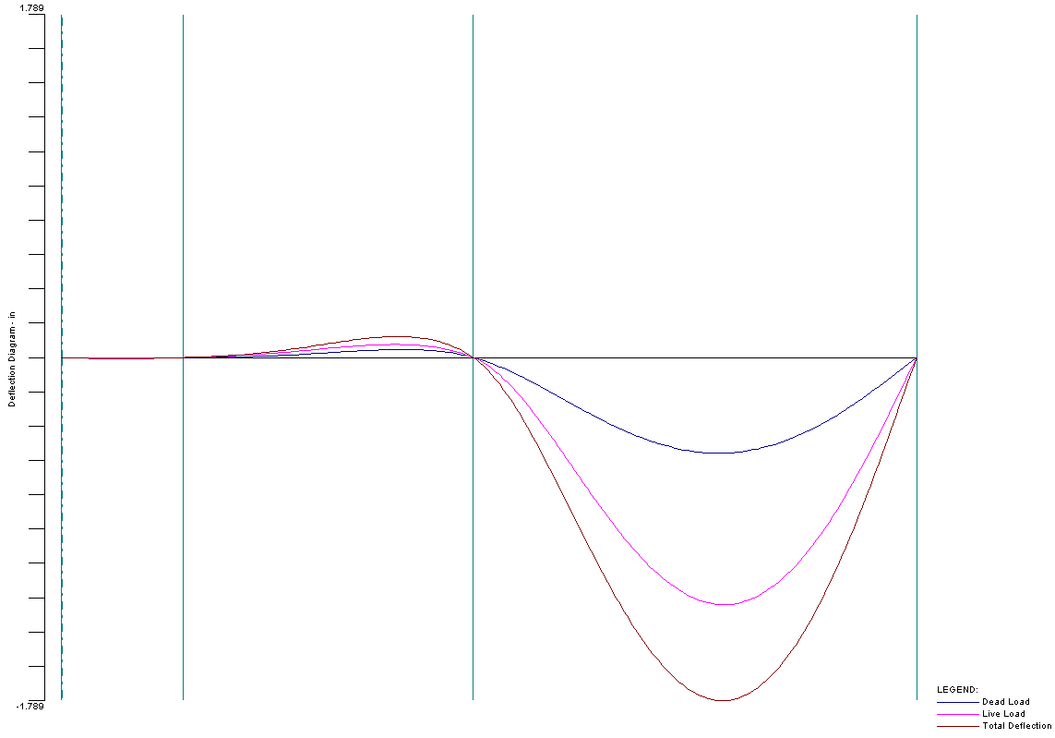
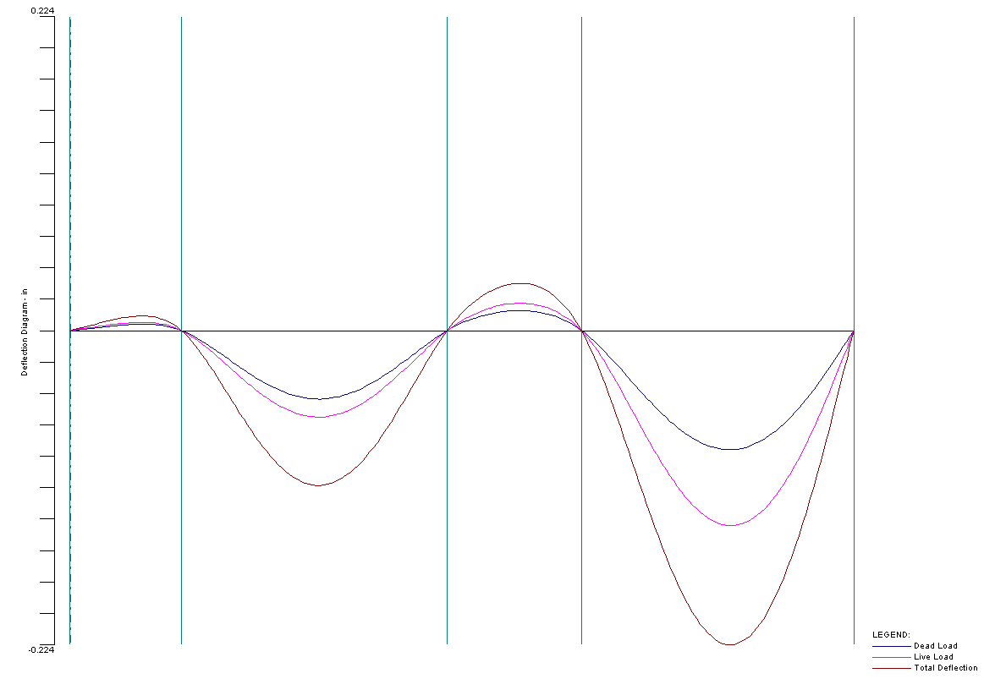
Game Day Building
Post Tensioned Redesign
PCA Slab Analysis & Design
PCA Slab Analysis & Design
Unit Strip Plan
Unit Strip
Isometric View
Unit Strip Plan
Unit Strip
Isometric View
By: Matthew Haapala
Unit Strip Deflection Diagram
Unit Strip Deflection Diagram
Total Deflection = 1.789”
Total Deflection = 0.224”
Existing Conditions
Thesis Proposal & Goals
Gravity System Redesign
Lateral System Redesign
Foundation Optimization
Cost & Schedule Analysis
Lighting Redesign
Conclusions

Slide 14
Game Day Building
Post Tensioned Redesign
PT Beam Hand Calculations
PT Beam Hand Calculations
Calculations
Designed in accordance with ACI 318-08 for:
  Flexural serviceability
  Ultimate flexural strength
  Shear and torsion
  Deflection
Every post tensioned beam analyzed at supports and midspan
Member loads determined by iterative moment distribution
  Pattern loading not critical
  Moment redistribution not performed
    e_{t}>.0075 (ACI 318-08 Sect. 8.4.2)
Beam/Slab effective T beams considered
By: Matthew Haapala
Existing Conditions
Thesis Proposal & Goals
Gravity System Redesign
Lateral System Redesign
Foundation Optimization
Cost & Schedule Analysis
Lighting Redesign
Conclusions
Notes:
B eff Additional 16x slab depth
½ clear distance to the next web
Chapter 18ACI says may not be appropriate
Post Tensioning Institute Tech Note 3 says ok
Majority of beams turned out to be Class U uncracked with tensile stresses f_{t} <=7.5*sqrt(f’c)
Remainder Were Class T 7.5*sqrt<(f’c)f_{t} <=12*sqrt(f’c)
14” beam full drape 9.5”
18” Deep Beam Full Drape 13.5” Façade Dead loads

Slide 15
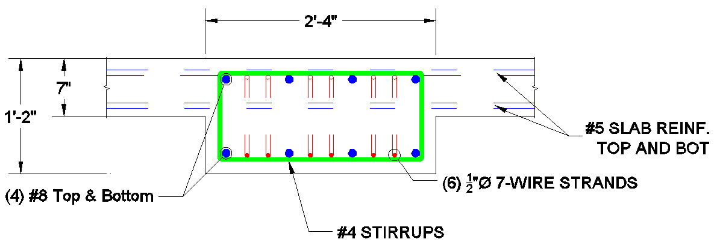
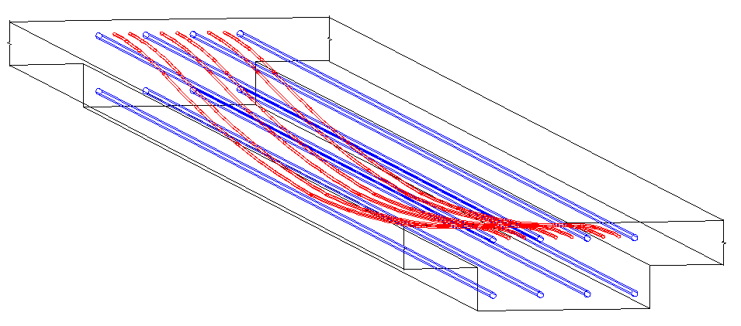
Game Day Building
Post Tensioned Redesign
PT Beam Hand Calculations
PT Beam Hand Calculations
Interior beams
  Depth: 14” = 2x slab depth of 7”
  Width: 12” - 40”, typ. 28”
  # Tendons: (5) - (13), typ. (6)
  Longitudinal Rebar: (3) - (5) #8 Top & Bottom , typ. (4)
Perimeter beams: depth 18”
  Depth 18” - 29”
  Width 12” - 24”, typ. 18”
  # Tendons: (4) - (6), typ. (4)
  Longitudinal Rebar : (2) - (4) #8 Top & Bottom, typ. (2)
On average76% dead load balanced after losses
Average Compressive Stress 164psi – 475psi, typ. 250 psi
  > Code required 125psi
  < 500psi reasonable maximum
By: Matthew Haapala
Existing Conditions
Thesis Proposal & Goals
Gravity System Redesign
Lateral System Redesign
Foundation Optimization
Cost & Schedule Analysis
Lighting Redesign
Conclusions
Notes:
Majority of beams turned out to be Class U uncracked with tensile stresses f_{t} <=7.5*sqrt(f’c)
Remainder Were Class T 7.5*sqrt<(f’c)f_{t} <=12*sqrt(f’c)
14” beam full drape 9.5”
18” Deep Beam Full Drape 13.5” Façade Dead loads

Slide 16
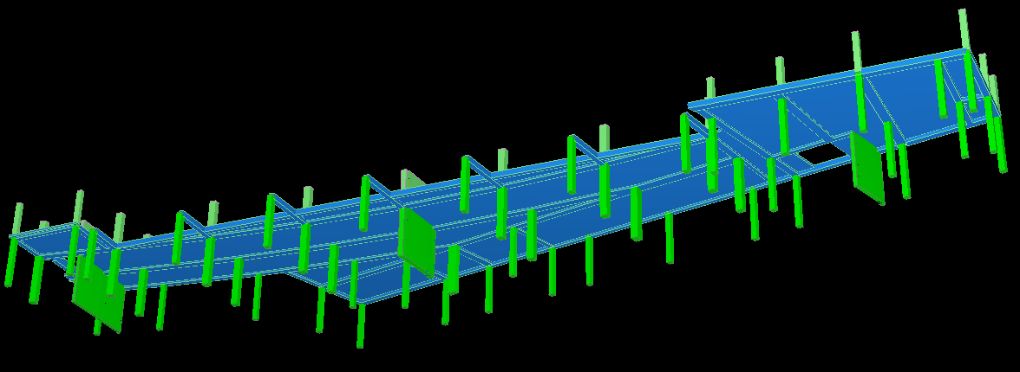
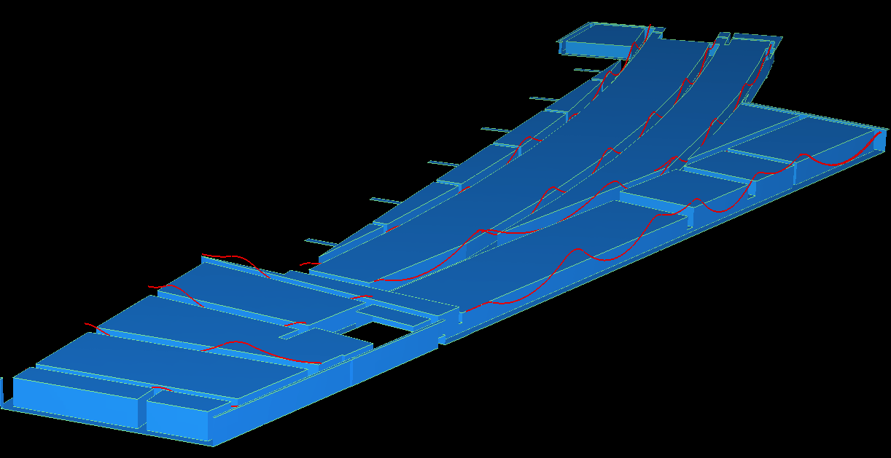
Game Day Building
Post Tensioned Redesign
RAM Concept Analysis
By: Matthew Haapala
Existing Conditions
Thesis Proposal & Goals
Gravity System Redesign
Lateral System Redesign
Foundation Optimization
Cost & Schedule Analysis
Lighting Redesign
Conclusions

Slide 17
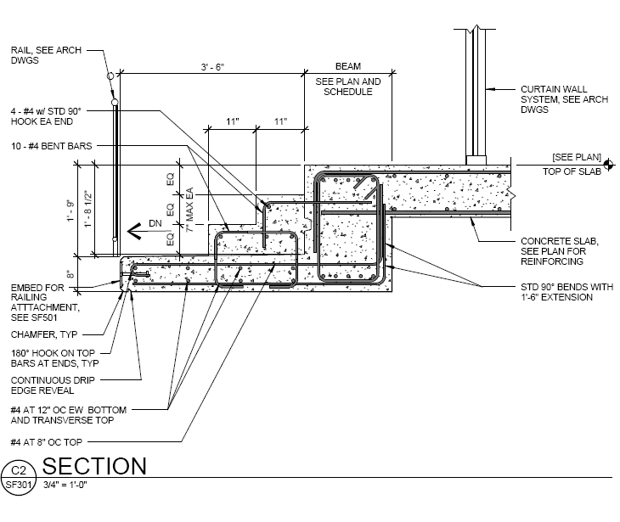
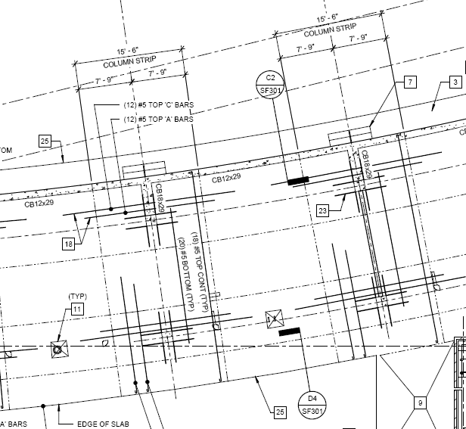
Game Day Building
Post Tensioned Redesign
Torsion & Deflection Design
By: Matthew Haapala
29”
12”
18”
9’-6”
31’-6”
Existing Conditions
Thesis Proposal & Goals
Gravity System Redesign
Lateral System Redesign
Foundation Optimization
Cost & Schedule Analysis
Lighting Redesign
Conclusions
18”x18” Edge Beams

Slide 18
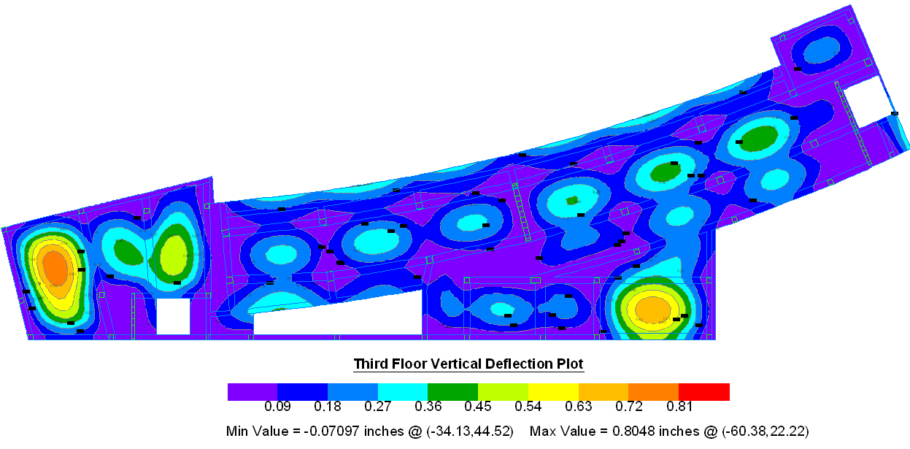
Game Day Building
Post Tensioned Redesign
Torsion & Deflection Design
By: Matthew Haapala
Typical Long Term Deflection Plan
Existing Conditions
Thesis Proposal & Goals
Gravity System Redesign
Lateral System Redesign
Foundation Optimization
Cost & Schedule Analysis
Lighting Redesign
Conclusions
Notes:
Live load deflections less than L/360
Long term deflections less than L/240

Slide 19
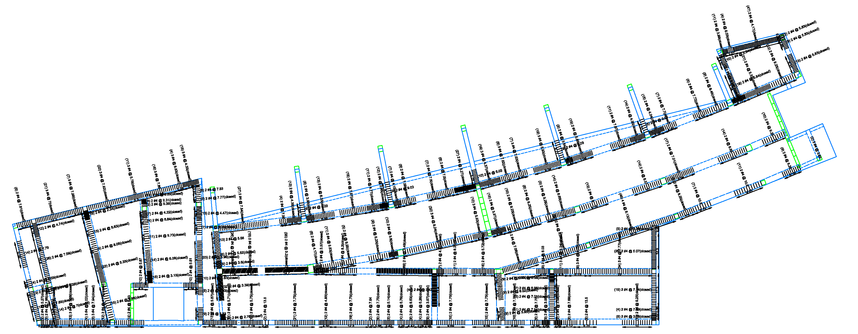
Game Day Building
Post Tensioned Redesign
2ND Floor Shear
Reinforcement Plan
By: Matthew Haapala
Existing Conditions
Thesis Proposal & Goals
Gravity System Redesign
Lateral System Redesign
Foundation Optimization
Cost & Schedule Analysis
Lighting Redesign
Conclusions

Slide 20
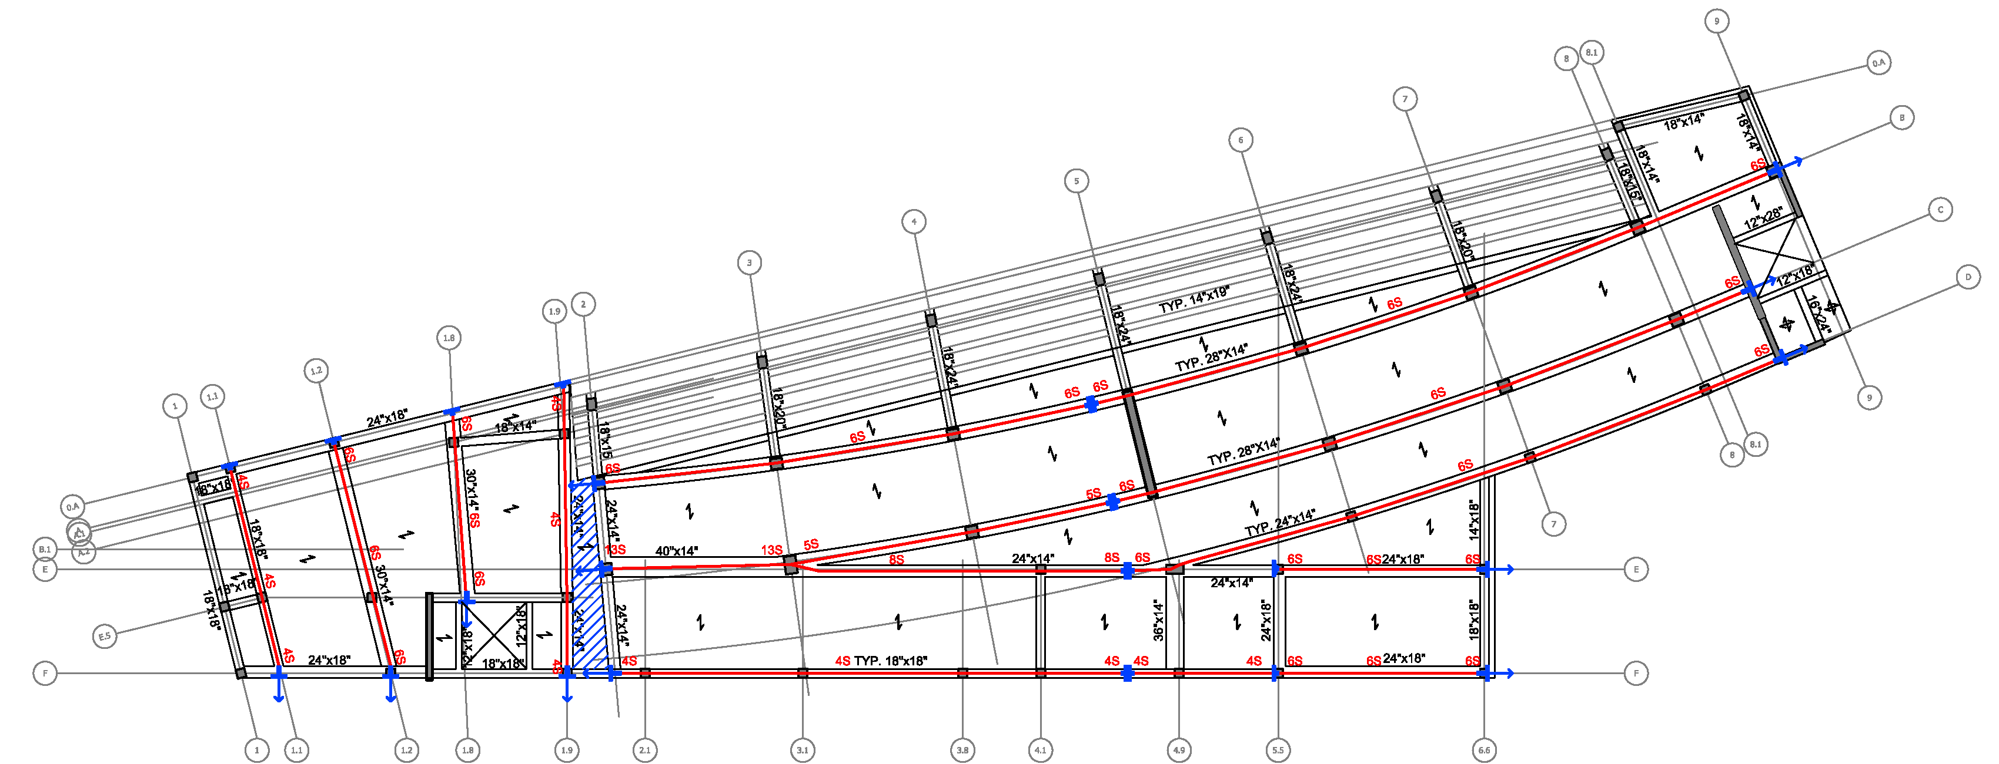
Game Day Building
Post Tensioned Redesign
2ND Floor Flexural
Reinforcement Plan
By: Matthew Haapala
Existing Conditions
Thesis Proposal & Goals
Gravity System Redesign
Lateral System Redesign
Foundation Optimization
Cost & Schedule Analysis
Lighting Redesign
Conclusions
Notes:
Location and # of Tendons shown in Red
Location and Type of Anchorage shown in Blue, Arrows Indicate Stressing location
Blue Hatched Area Temporary Pour Strip
Typical Slab Reinforcement #5 @ 12” Top and Bottom in direction of span
#5 @ 18” OC in perpendicular direction for temp and shrinkage

Slide 21
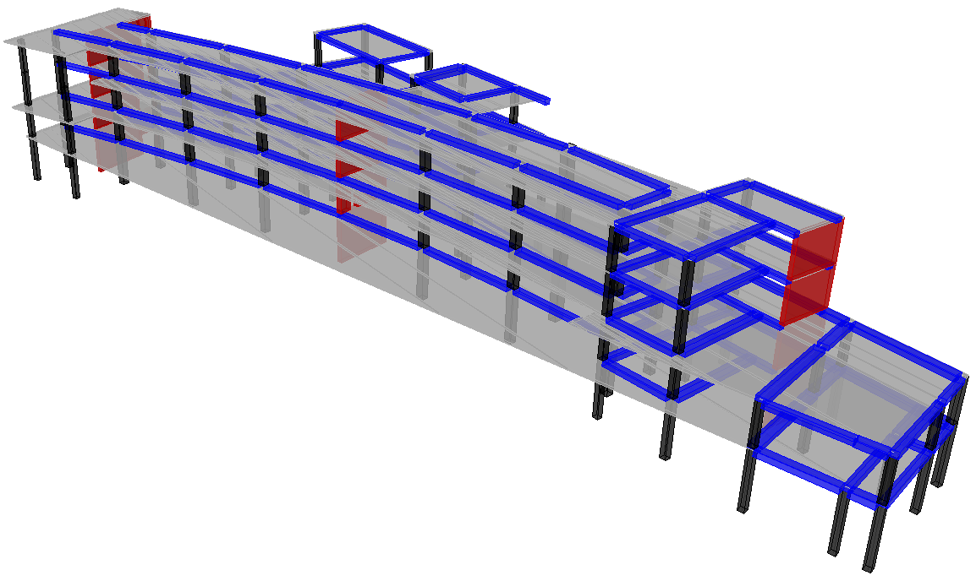
Game Day Building
Post Tensioned Redesign
Lateral System Redesign
By: Matthew Haapala
Existing Conditions
Thesis Proposal & Goals
Gravity System Redesign
Lateral System Redesign
Foundation Optimization
Cost & Schedule Analysis
Lighting Redesign
Conclusions

Slide 22
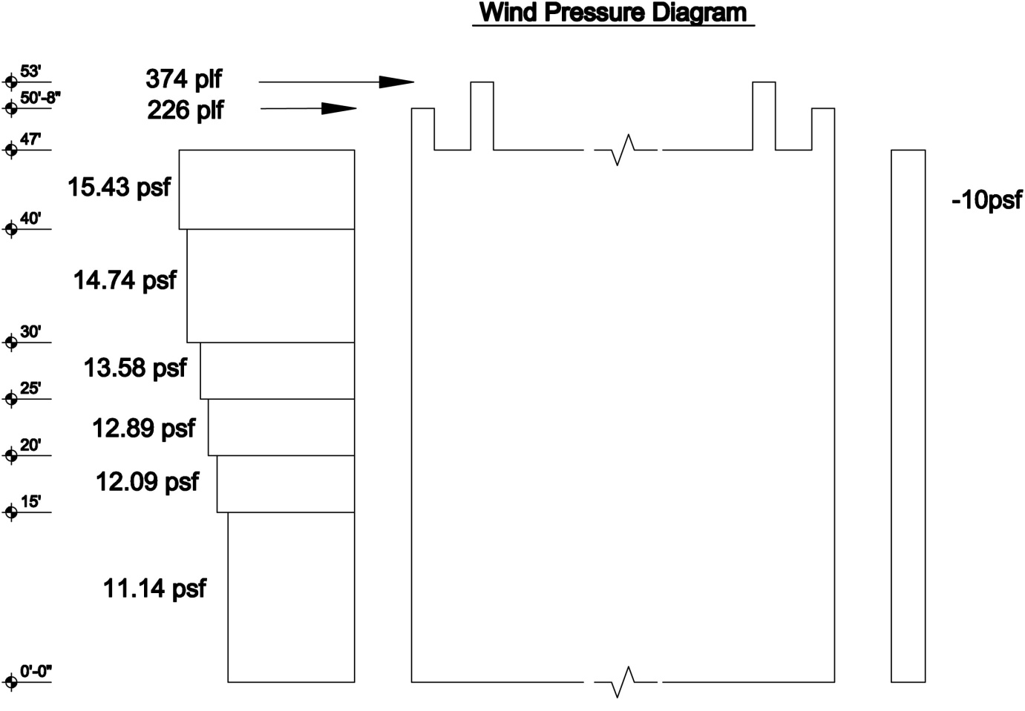
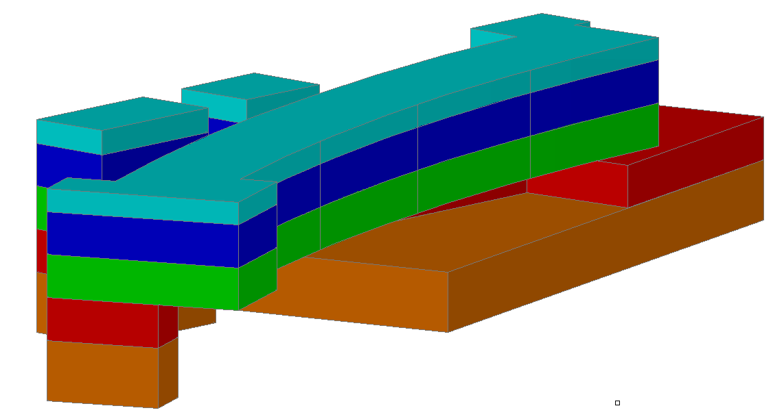
Game Day Building
Post Tensioned Redesign
Wind Loading
Wind Loading
By: Matthew Haapala
Existing Conditions
Thesis Proposal & Goals
Gravity System Redesign
Lateral System Redesign
Foundation Optimization
Cost & Schedule Analysis
Lighting Redesign
Conclusions

Slide 23
Game Day Building
Post Tensioned Redesign
Seismic Loading
Seismic Loading
By: Matthew Haapala
Existing Conditions
Thesis Proposal & Goals
Gravity System Redesign
Lateral System Redesign
Foundation Optimization
Cost & Schedule Analysis
Lighting Redesign
Conclusions

Slide 24
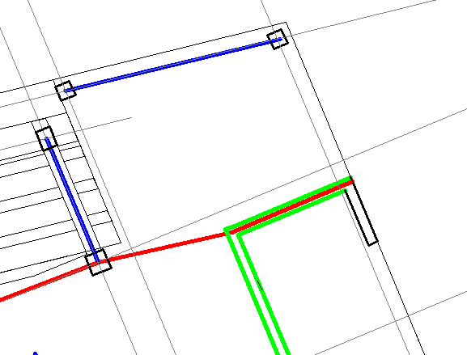
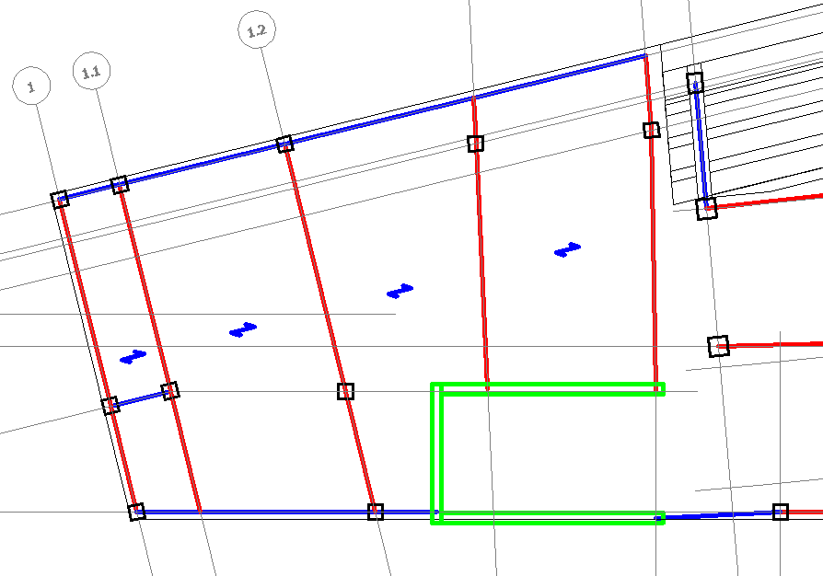
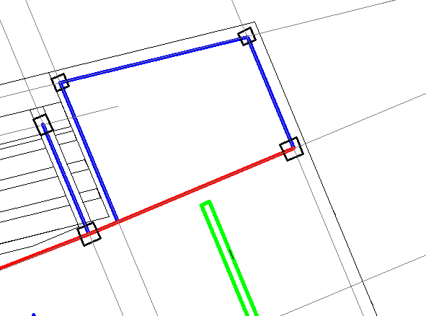
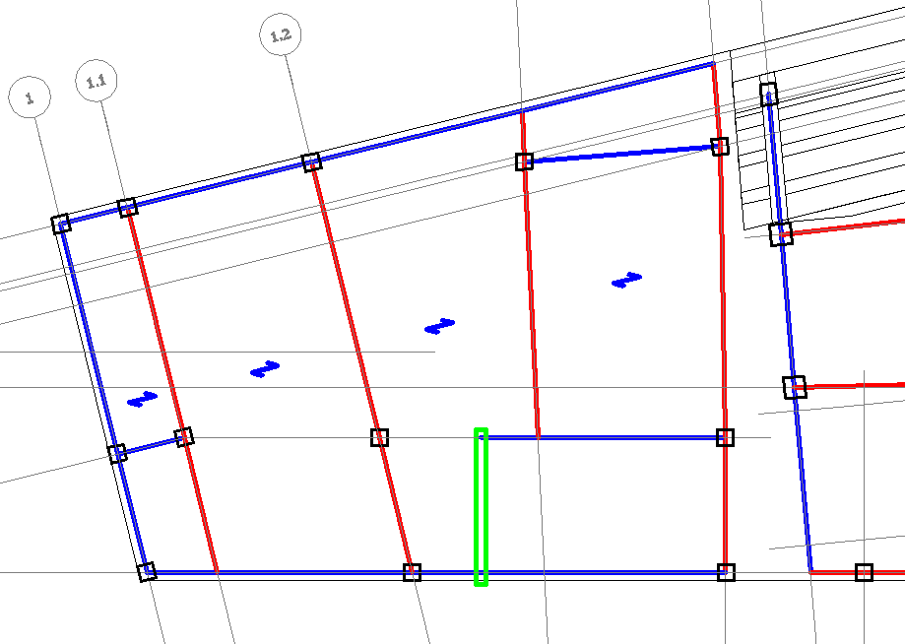
Game Day Building
Post Tensioned Redesign
Shear Wall 7 Removal
Shear Walls 1 & 3 Removal
By: Matthew Haapala
Existing Conditions
Thesis Proposal & Goals
Gravity System Redesign
Lateral System Redesign
Foundation Optimization
Cost & Schedule Analysis
Lighting Redesign
Conclusions

Slide 25
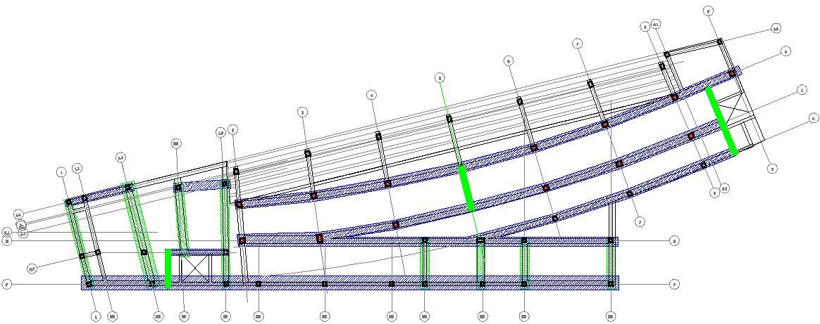
Game Day Building
Post Tensioned Redesign
Lateral System Plan
By: Matthew Haapala
Existing Conditions
Thesis Proposal & Goals
Gravity System Redesign
Lateral System Redesign
Foundation Optimization
Cost & Schedule Analysis
Lighting Redesign
Conclusions

Slide 26
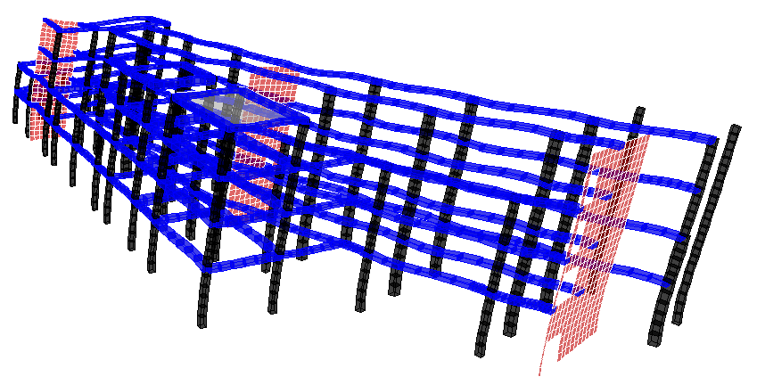
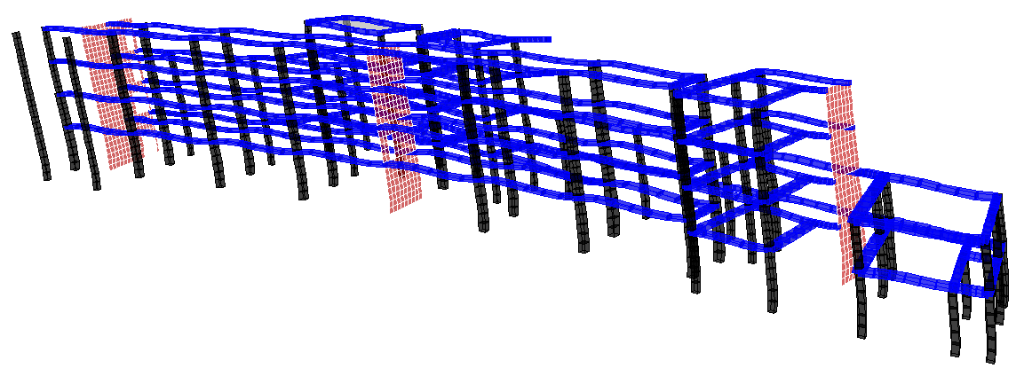
Game Day Building
Post Tensioned Redesign
South Wind Deflected Shape
Seismic Deflected Shape
By: Matthew Haapala
Existing Conditions
Thesis Proposal & Goals
Gravity System Redesign
Lateral System Redesign
Foundation Optimization
Cost & Schedule Analysis
Lighting Redesign
Conclusions

Slide 27
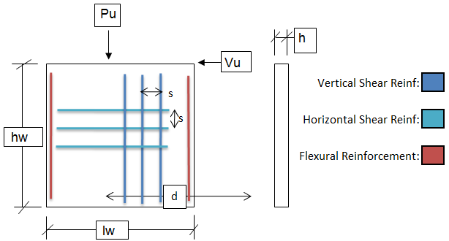
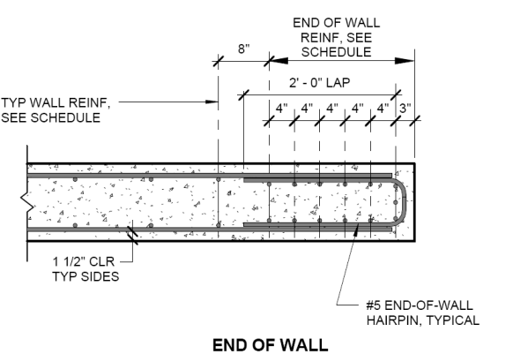
Game Day Building
Post Tensioned Redesign
Shear Wall Design
Loading
Load Combo | 1.2D+1.6W+L | 0.9D+1.6W | 1.2D+1.0E+L | 0.9D+1.0E
P_{u} (Kips) | 1127 | 606 | 1128 | 606
V_{u} (Kips) | 174 | 201 | 27 | 54
M_{u} (K-ft) | 8001 | 7965 | 3370 | 3333
By: Matthew Haapala
F Design Values
F Tension | 0.9
F Shear | 75
F Comp. | 0.65
Geometry
l_{w} (in) | 222
h (in) | 18
h_{w} (in) | 180
d % | 80.00%
A (in^2) | 3996
S (in^3) | 147852
I (in^4) | 16411572
Material Properties
f'c | 6000
f_{y} | 60000
Shear Reinforcement Req'd
# of Curtains Req'd | 1
As min (in^2/ft) | 0.54
Max Spacing (in) | 13.78
Shear Reinforcement Design
# of Curtains | 2
Bar Size | #5
Bar Spacing (in) | 12
ac | 3
rt | 0.006
FVn (Kips) | 268
Vu/FVn | 75%
Flexural Reinforcement Req'd
Boundary Zone | No
Flexural Reinforcement Design
# of Bars | 7
Bar Size | #9
FMn>Mu,FPn>Pu | Yes
Flexural Reinforcement Detail
Existing Conditions
Thesis Proposal & Goals
Gravity System Redesign
Lateral System Redesign
Foundation Optimization
Cost & Schedule Analysis
Lighting Redesign
Conclusions

Slide 28
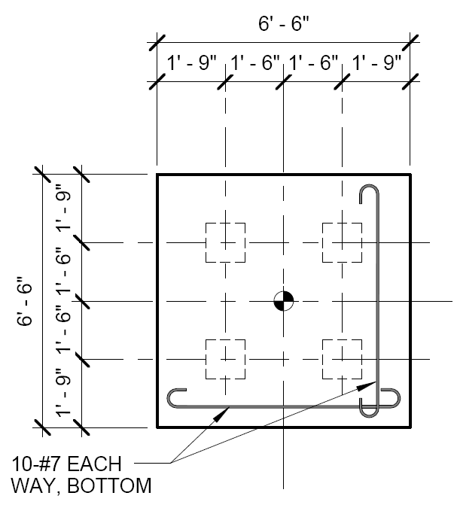
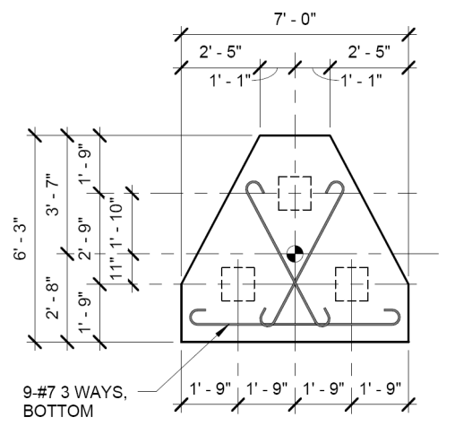
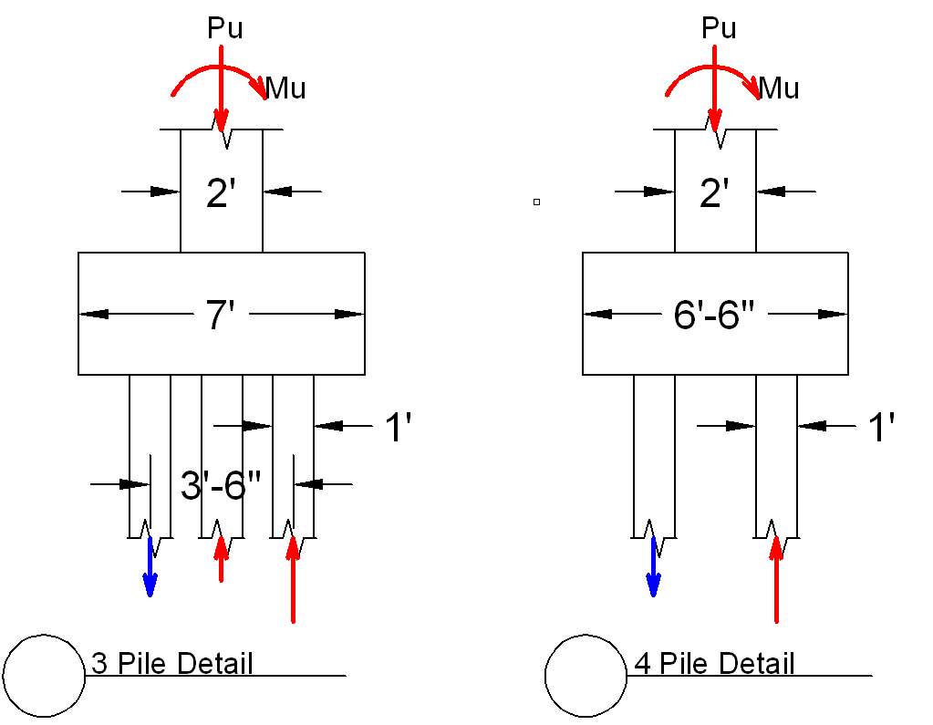
Game Day Building
Post Tensioned Redesign
Foundation Optimization
Foundation Optimization
By: Matthew Haapala
Existing Conditions
Thesis Proposal & Goals
Gravity System Redesign
Lateral System Redesign
Foundation Optimization
Cost & Schedule Analysis
Lighting Redesign
Conclusions

Slide 29
Game Day Building
Post Tensioned Redesign
Cost Analysis
By: Matthew Haapala
Existing Conditions
Thesis Proposal & Goals
Gravity System Redesign
Lateral System Redesign
Foundation Optimization
Cost & Schedule Analysis
Lighting Redesign
Conclusions

Slide 30
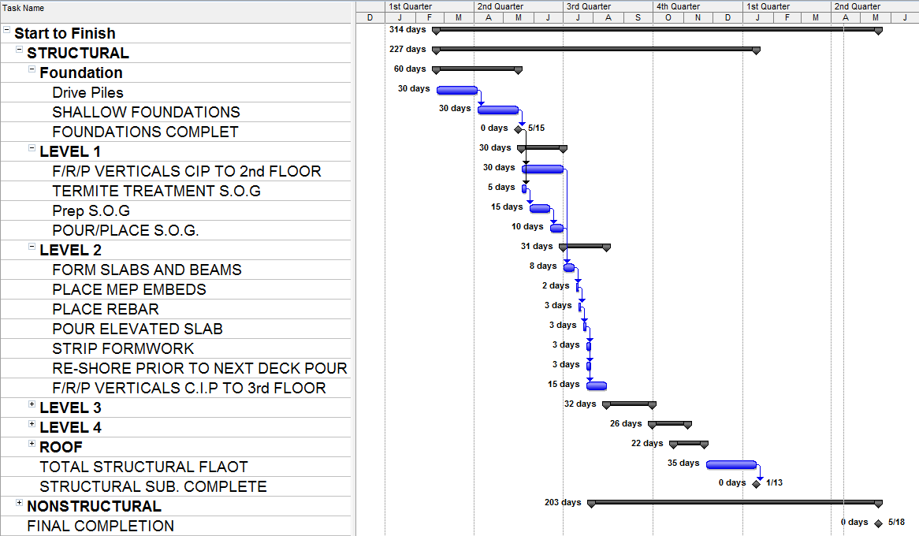
Game Day Building
Post Tensioned Redesign
Original Design Schedule
By: Matthew Haapala
Existing Conditions
Thesis Proposal & Goals
Gravity System Redesign
Lateral System Redesign
Foundation Optimization
Cost & Schedule Analysis
Lighting Redesign
Conclusions

Slide 31
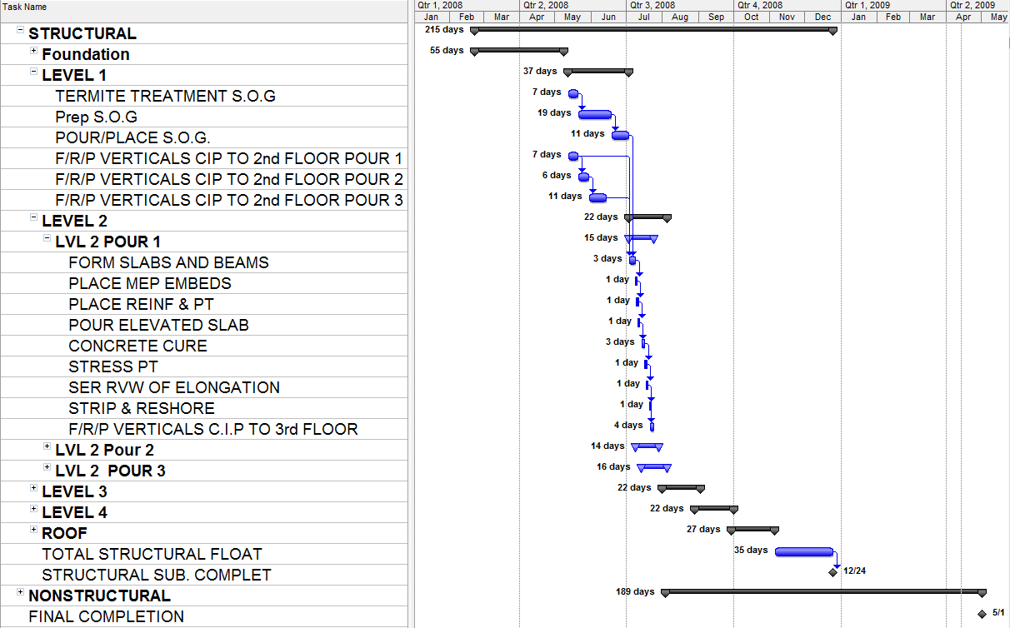
Game Day Building
Post Tensioned Redesign
New Design Schedule
Construction Sequence
By: Matthew Haapala
Existing Conditions
Thesis Proposal & Goals
Gravity System Redesign
Lateral System Redesign
Foundation Optimization
Cost & Schedule Analysis
Lighting Redesign
Conclusions
Sequence 2
Sequence 1
Sequence 3

Slide 32
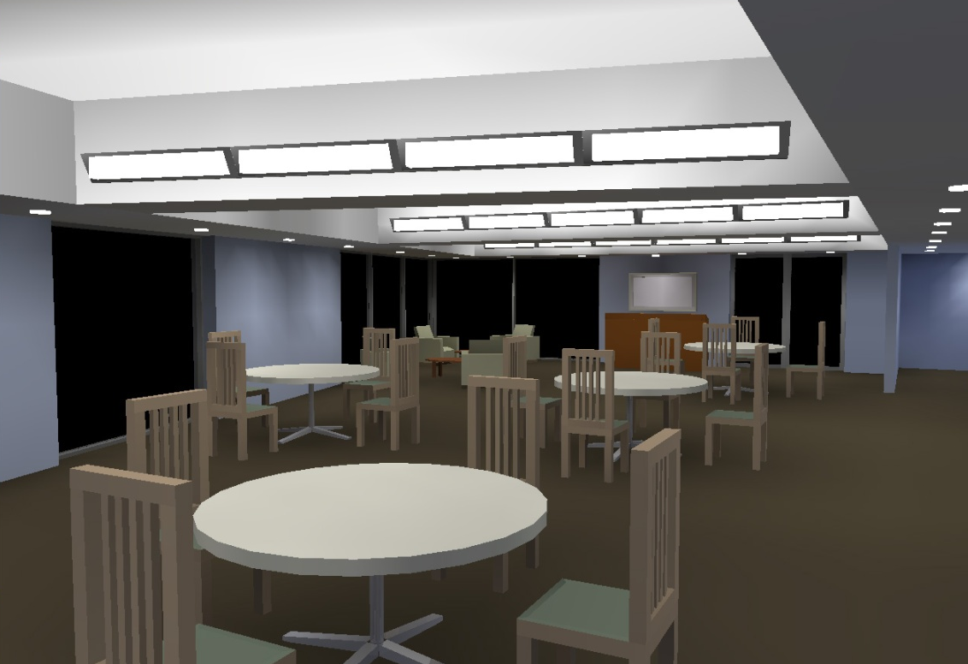
Game Day Building
Post Tensioned Redesign
Lighting Redesign
By: Matthew Haapala
Existing Conditions
Thesis Proposal & Goals
Gravity System Redesign
Lateral System Redesign
Foundation Optimization
Cost & Schedule Analysis
Lighting Redesign
Conclusions

Slide 33
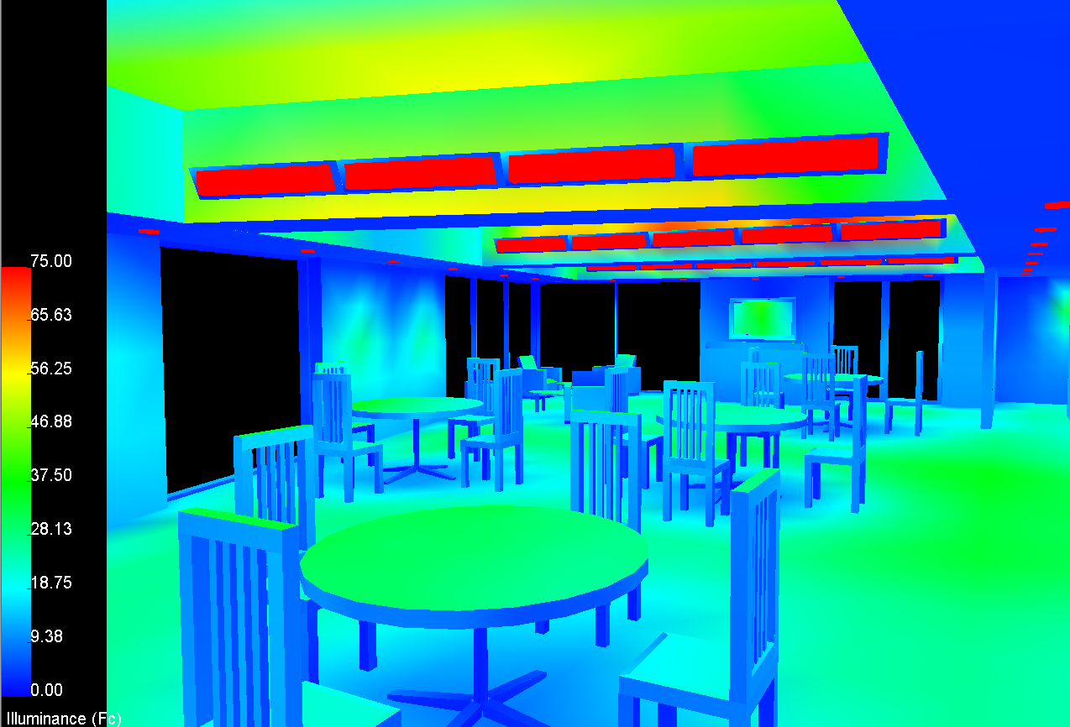
Game Day Building
Post Tensioned Redesign
Pseudo Color Rendering
By: Matthew Haapala
Existing Conditions
Thesis Proposal & Goals
Gravity System Redesign
Lateral System Redesign
Foundation Optimization
Cost & Schedule Analysis
Lighting Redesign
Conclusions

Slide 34
Game Day Building
Post Tensioned Redesign
Conclusions
Gravity System Redesign
  Slab depth reduced by 5”
  Floor depth increase at beams only 2”
  Buildings weight reduced by 36%
Lateral System Redesign
  4 out of 7 shear walls removed
  Lateral loading does not control beam design
Foundation Optimization
  Number of Piles Reduced by 15%
Cost and Schedule Analysis
  $238,000 in savings
  Structural erection expedited
Lighting Redesign
  Non uniform floor depth can improve aesthetics
By: Matthew Haapala
Existing Conditions
Thesis Proposal & Goals
Gravity System Redesign
Lateral System Redesign
Foundation Optimization
Cost & Schedule Analysis
Lighting Redesign
Conclusions
Notes:
16% structural cost, 2% total project cost

Slide 35
Game Day Building
Post Tensioned Redesign
Acknowledgements
Professional Consultants
Rich Apple Holbert Apple Associates
Peter A. Allen Clark Nexsen
Brian M. Barna Clark Nexsen
Alicia B, Udovich Clark Nexsen
John Wilson Clark Nexsen
AE Dept. Faculty
Dr. Walter Schneider III
Dr. Andres Lepage
Dr. Linda Hanagan
Dr. Ali Memari
Dr. John Messner
Classmates, Friends, and Family
By: Matthew Haapala
Existing Conditions
Thesis Proposal & Goals
Gravity System Redesign
Lateral System Redesign
Foundation Optimization
Cost & Schedule Analysis
Lighting Redesign
Conclusions

Slide 36
Game Day Building
Post Tensioned Redesign
Questions?
By: Matthew Haapala
Existing Conditions
Thesis Proposal & Goals
Gravity System Redesign
Lateral System Redesign
Foundation Optimization
Cost & Schedule Analysis
Lighting Redesign
Conclusions

